Slide 1

Library Management System
MPP Group 2
Issa Fikadu
Ashraf Elayed
Pat Adrian Limosnero

Slide 2
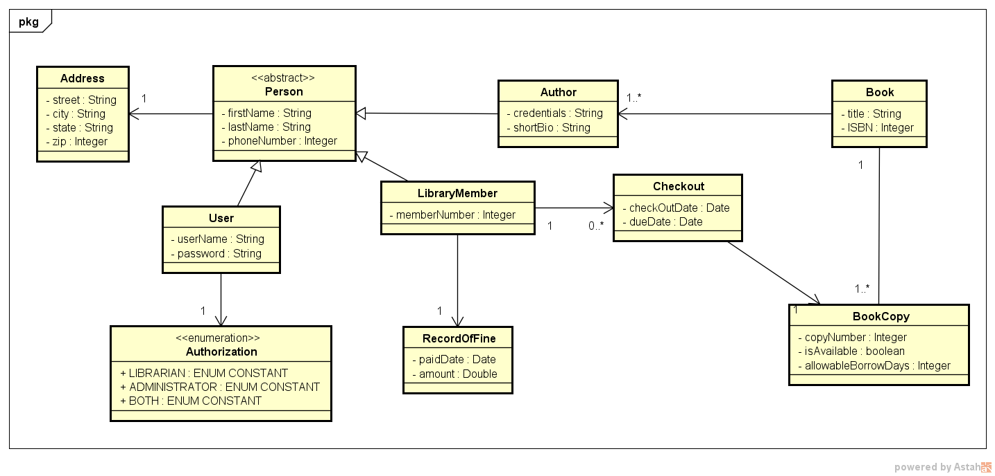
Class Diagram

Slide 3
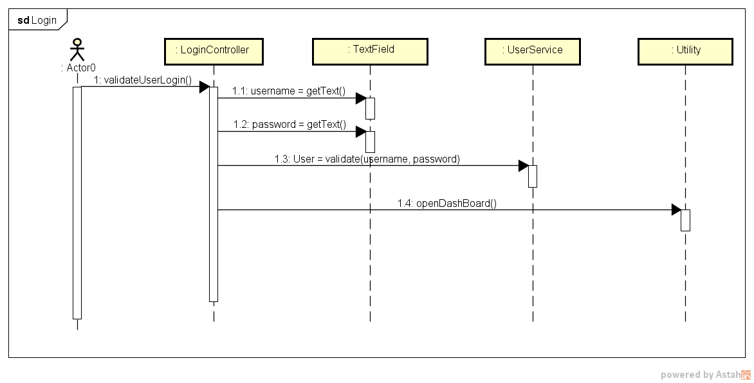
Sequence Diagram - Login

Slide 4
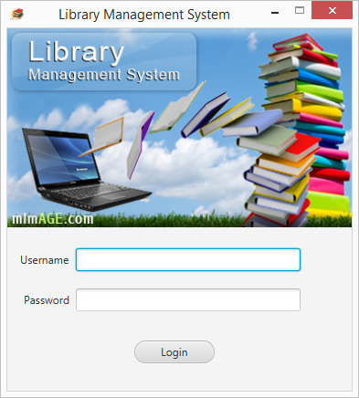
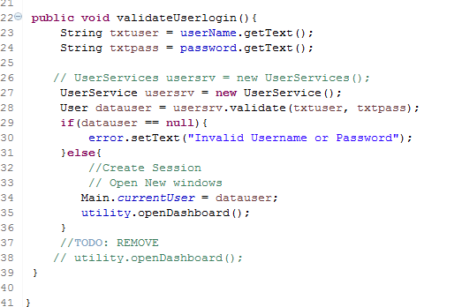
Screen Shot - Login

Slide 5
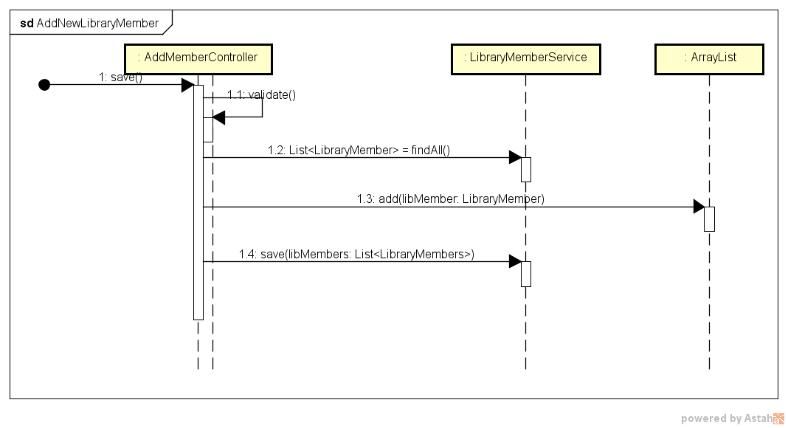
Sequence Diagram – Add New Library Member

Slide 6
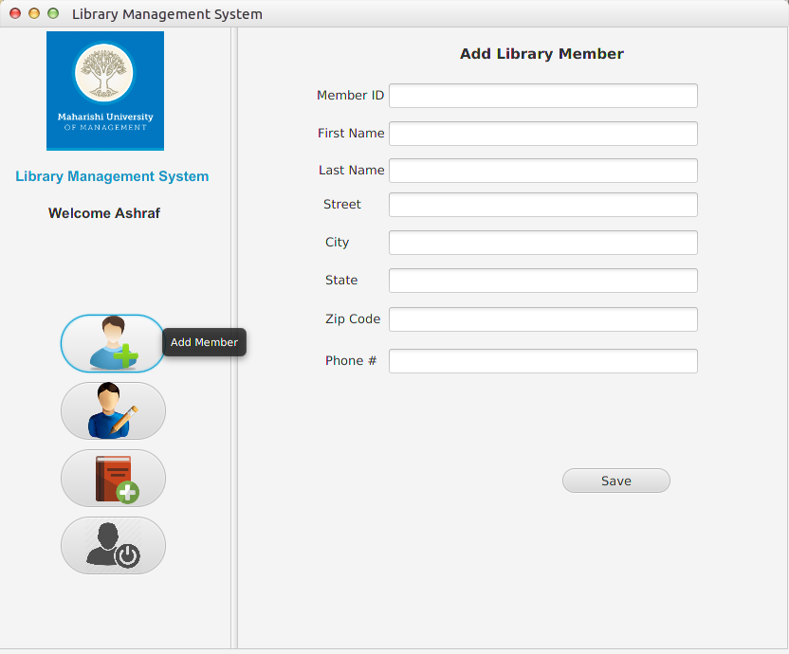
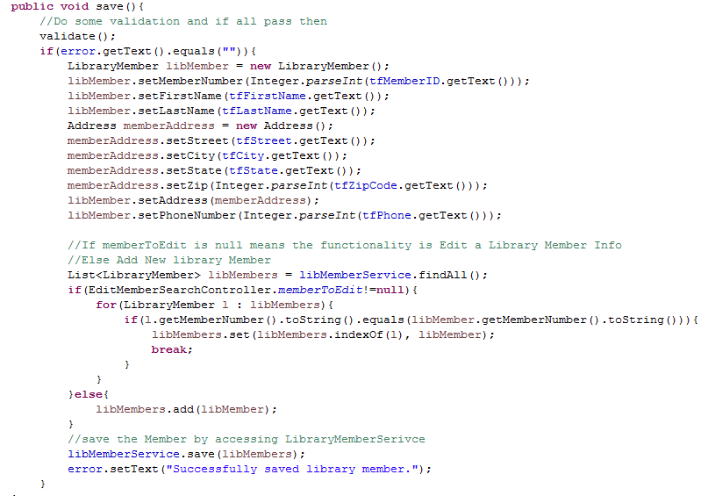
Screen Shot – Add New Library Member

Slide 7
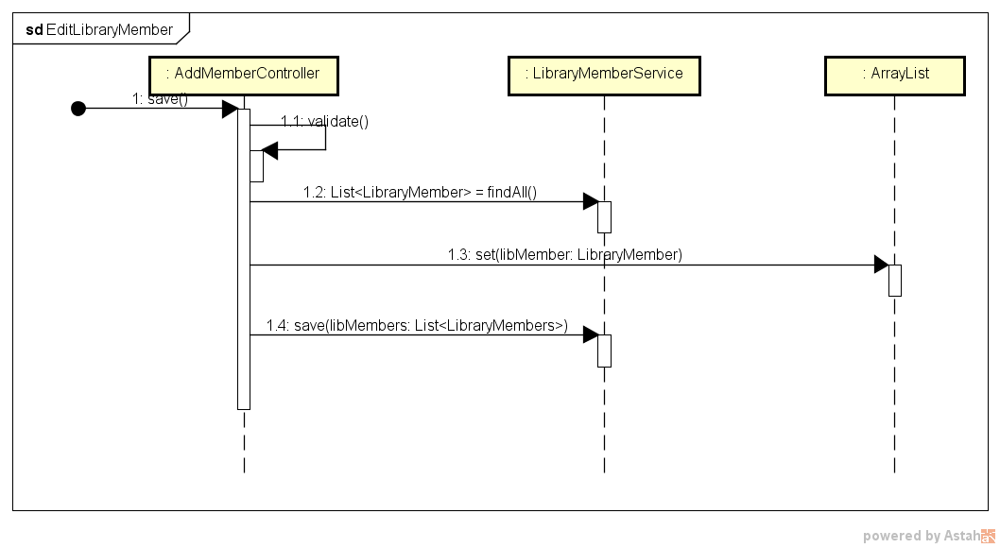
Sequence Diagram – Edit New Library Member

Slide 8
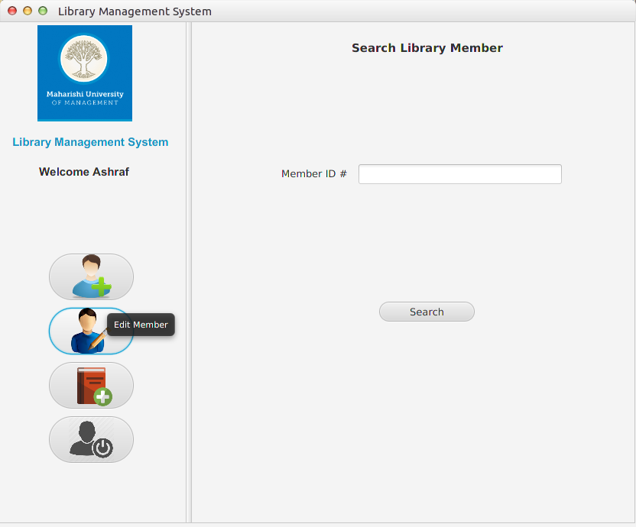
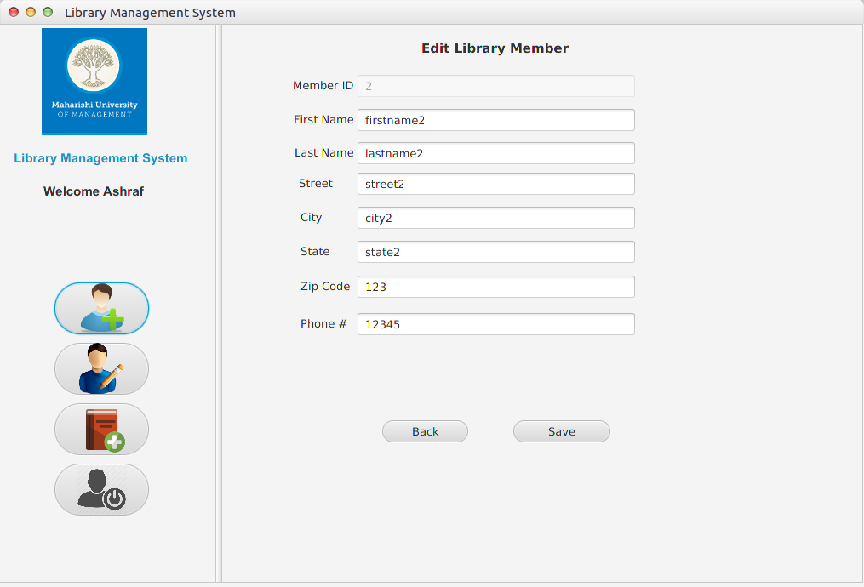
Screen Shot – Edit Library Member Information

Slide 9
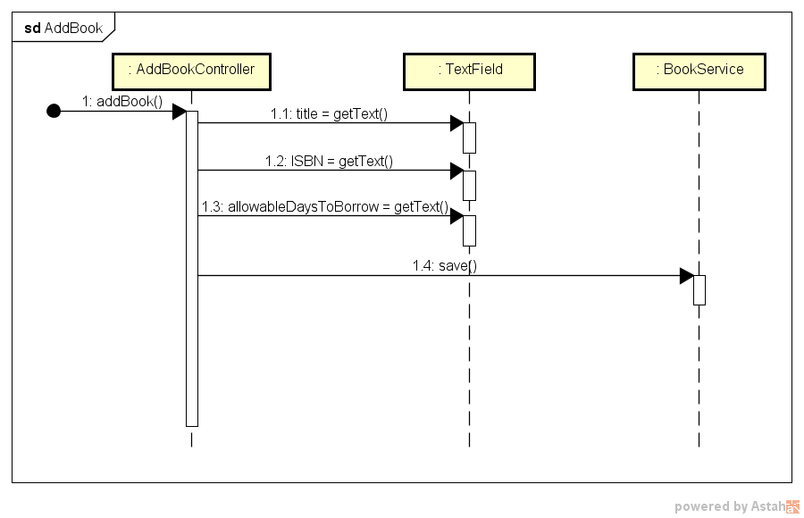
Sequence Diagram – Add Book

Slide 10
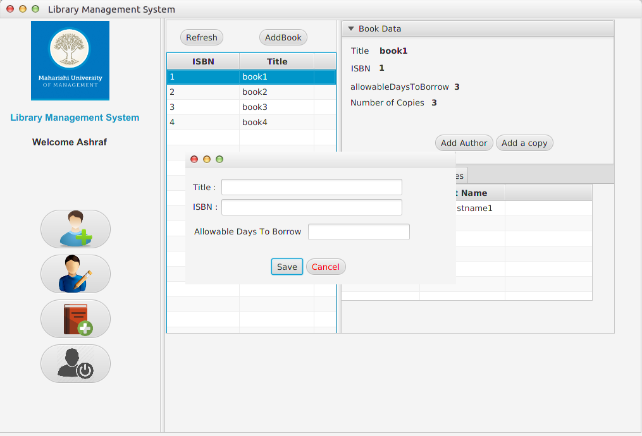
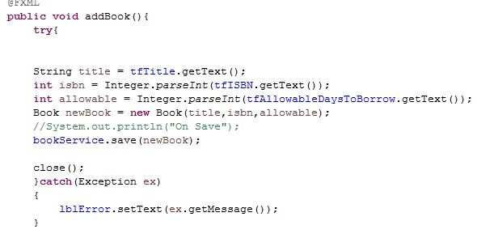
Screen Shot – Add Book

Slide 11
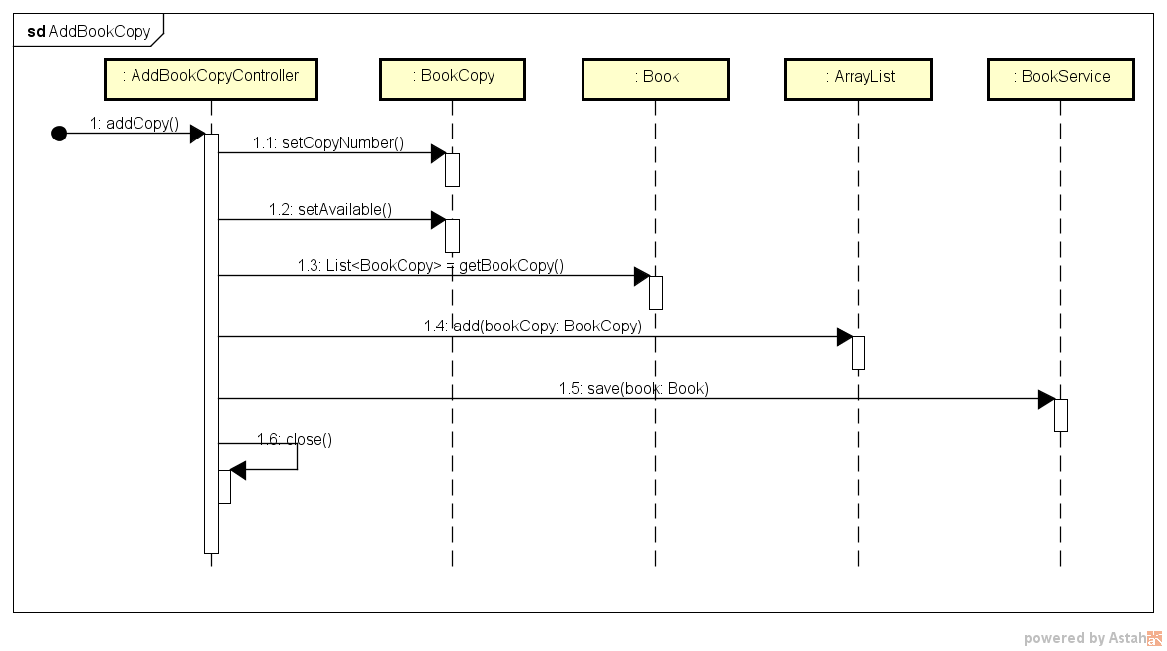
Sequence Diagram – Add Book Copy

Slide 12
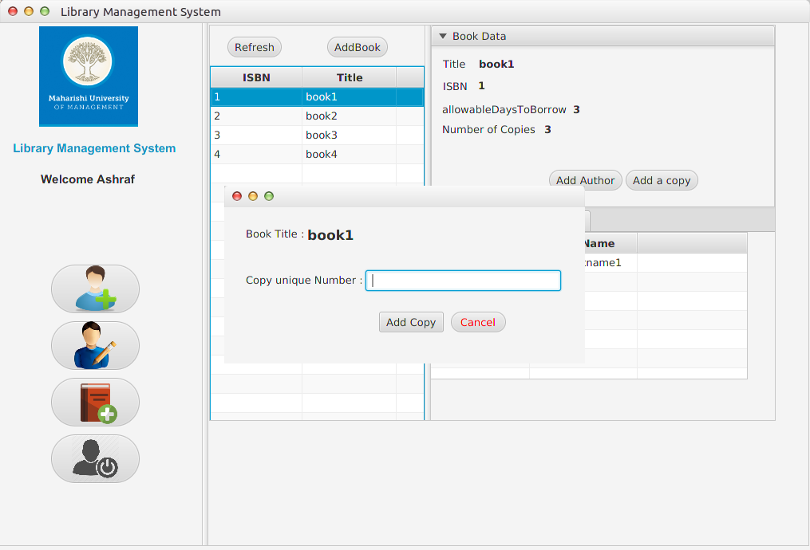
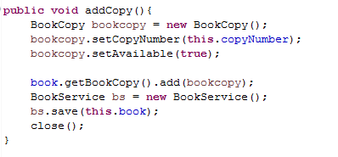
Screen Shot – Add Book Copy

Slide 13
Sequence Diagram – Check Out Book

Slide 14


Slide 15


